Slide 1
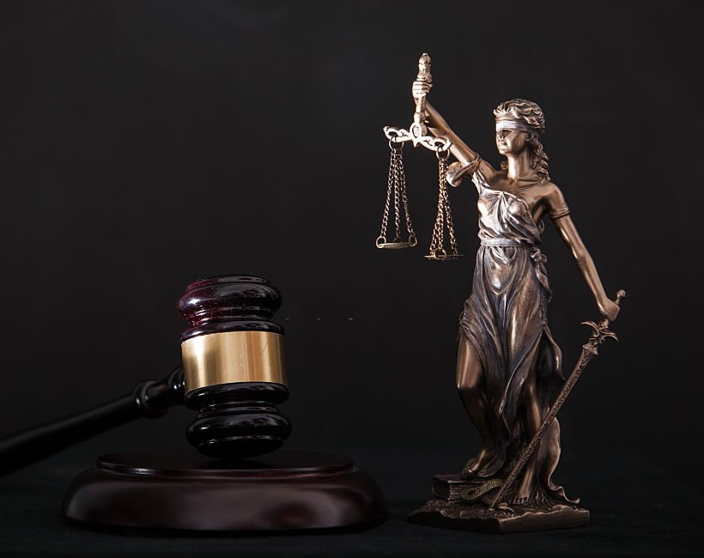
Creating BNS Helper Using NLP
Notes:
Good evening sir, this is our project from words to strokes

Slide 2
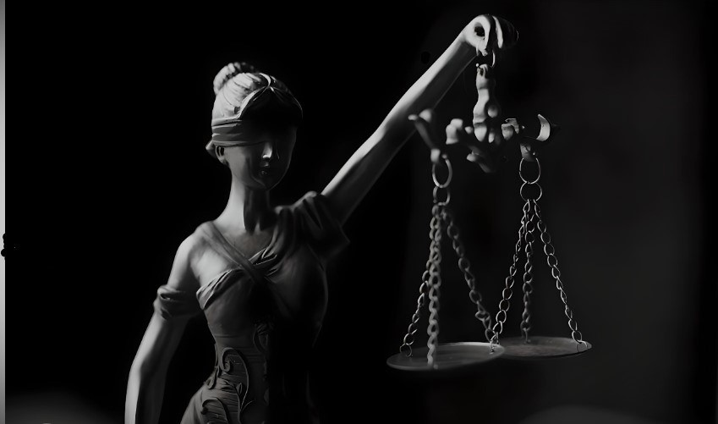
01 Overview
A Glimpse into our Project Methodology

Slide 3
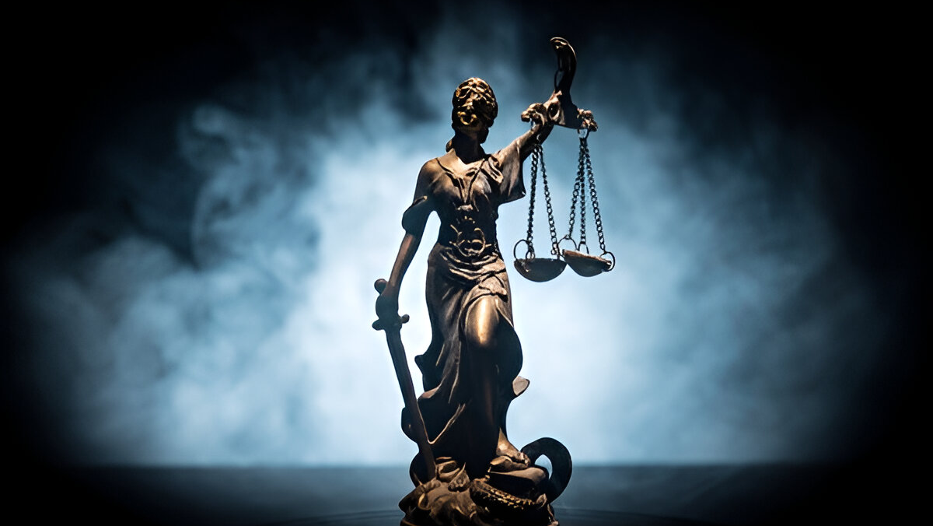
Project Details
Major Project Presentation -II
Our Team
Title: Creating BNS Helper Using NLP
Project Guide: Prof. Mahesh Kumar
Project No. : MK-2
Sapeksh Pareek (211B274)
Sarthak Nagar (211B276)
Shivansh Bhatnagar (211B296)

Slide 4
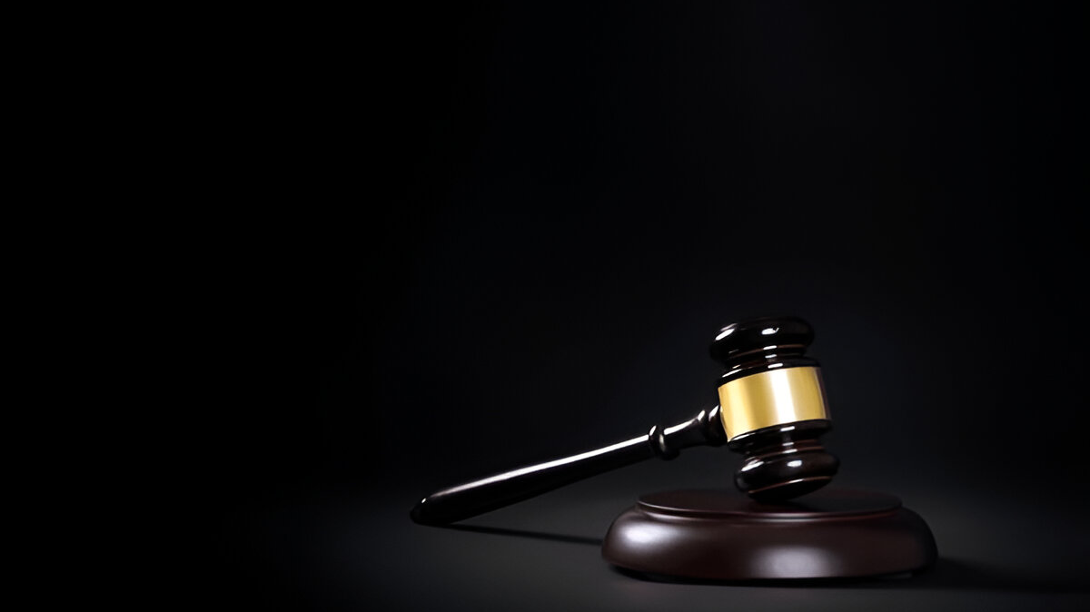
Problem Statement
Indian Penal Code changes to Bhartiya Nyaay Sahita, We don’t have its proper database, many officials refer to Govt. website for any research about any article as they don’t remember BNS system like previous IPC.
Notes:
Our project is about to create an exclusive dataset that hasn’t been created yet and its of rishi Pranali.
Rishi Pranali in is not a new term for Indian judiciary system, courts are using this from decades to record all the proceeding. Anything which is mentioned in a court hearing from the filing of the till verdict including all the statements given by victims, witnesses, advocates and judges. It is a symbolic language used by stenographer to record all these statements.

Slide 5
Motivation for Project
People don’t have to remember aur research much about any article they will be able to get all the details by just few clicks.
Digitalising Indian court systems for better AL/ML use.
Notes:
Our project is about to create an exclusive dataset that hasn’t been created yet and its of rishi Pranali.
Rishi Pranali in is not a new term for Indian judiciary system, courts are using this from decades to record all the proceeding. Anything which is mentioned in a court hearing from the filing of the till verdict including all the statements given by victims, witnesses, advocates and judges. It is a symbolic language used by stenographer to record all these statements.

Slide 6
02 TechStack
Architectural Heartbeat of the System

Slide 7
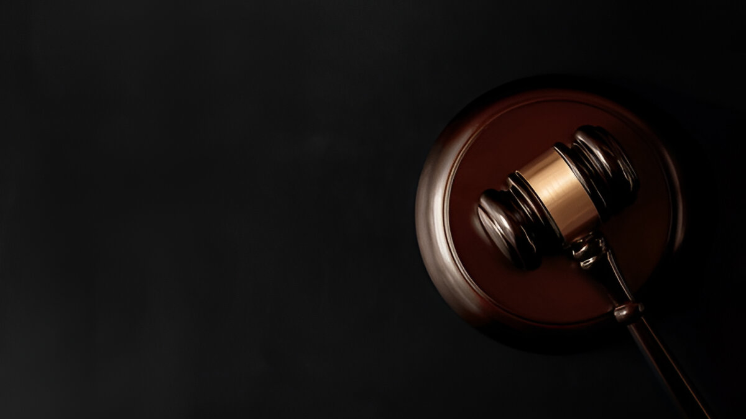
Techstack
Python 3.10
spaCy
NLTK
Tensorflow
Bidirectional Encoder Representation Transformers
Facebook Artificial Intelligence Similarity Search
Generative Pre-trained Transformers
Notes:
Our project is about to create an exclusive dataset that hasn’t been created yet and its of rishi Pranali.
Rishi Pranali in is not a new term for Indian judiciary system, courts are using this from decades to record all the proceeding. Anything which is mentioned in a court hearing from the filing of the till verdict including all the statements given by victims, witnesses, advocates and judges. It is a symbolic language used by stenographer to record all these statements.

Slide 8
03 SystemArch
Architectural Heartbeat of the System

Slide 9

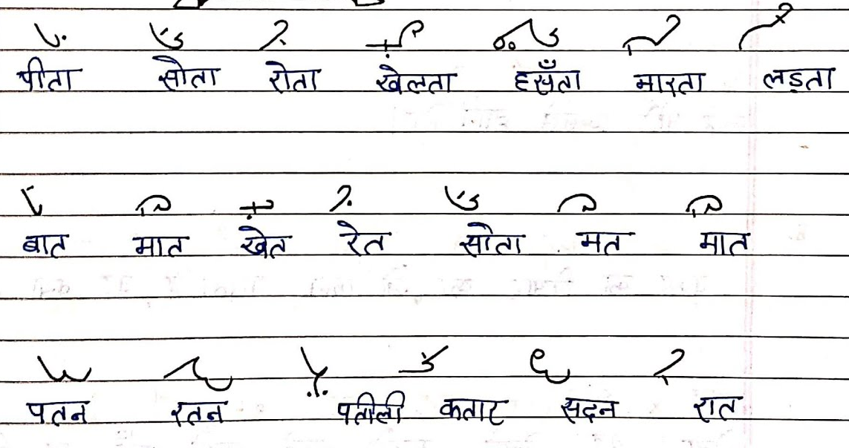
Examples how Rishi Pranali Looks.
Notes:
This is how rishi Pranali looks like.

Slide 10
Deep Learning & Neural Networks
Deep Learning is a subset of machine learning that uses neural networks to solve complex problem.
TensorFlow is a powerful open-source machine learning framework.
PyTorch is a deep learning framework use in AI.
RNN is use for sequence modelling like text recognition.
R-CNN is object detection framework use for accurately localization for classification of images.

Slide 11
System Architecture
Dataset
Take available Hindi dataset to train our model.
Model
Design model using TensorFlow to work on Hindi input.
OCR
Take input in the form of Image or Text and generate abbreviated texts using Deep Learning.
Algo
Rishi
Using Proprietary algorithm for abbreviated text.
Output in the form of Rishi Pranali.

Slide 12
04 Timeline
A Step-by-Step Odyssey

Slide 13
Timeline
P1
P2
P2
P2
P3
P3
Research
Creating Dataset
Working on Responses
Training Model
Fine Tuning
Final Application

Slide 14
05 Synopsis
A Pithy Recap

Slide 15
Conlusion
In conclusion, we would like to convey that we have curated a dataset known as Rishi Pranali with the purpose of offering substantial assistance to the future initiatives of the Indian judiciary.

Slide 16
Thankyou!

